Slide 1
Integrating Health Research: Mechanisms to Populations
Emma Vincent
Chrissy Hammond

Slide 2
Housekeeping
Introduction to Integrating Health Research: Mechanisms to Populations – Emma Vincent
Engaging with Integrating Health Research: Mechanisms to Populations – Ruth Mitchell
Q&A session
Please could everyone have their videos switched off and remain muted - we will invite people to unmute at the Q&A session.
For the Q&A session please use the chat function for questions and feel free to post them throughout the presentations.
Please note that this meeting is being recorded.
We will make the slides and recording available for attendees following the meeting.

Slide 3
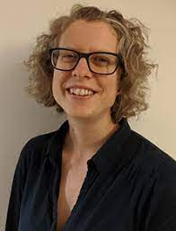
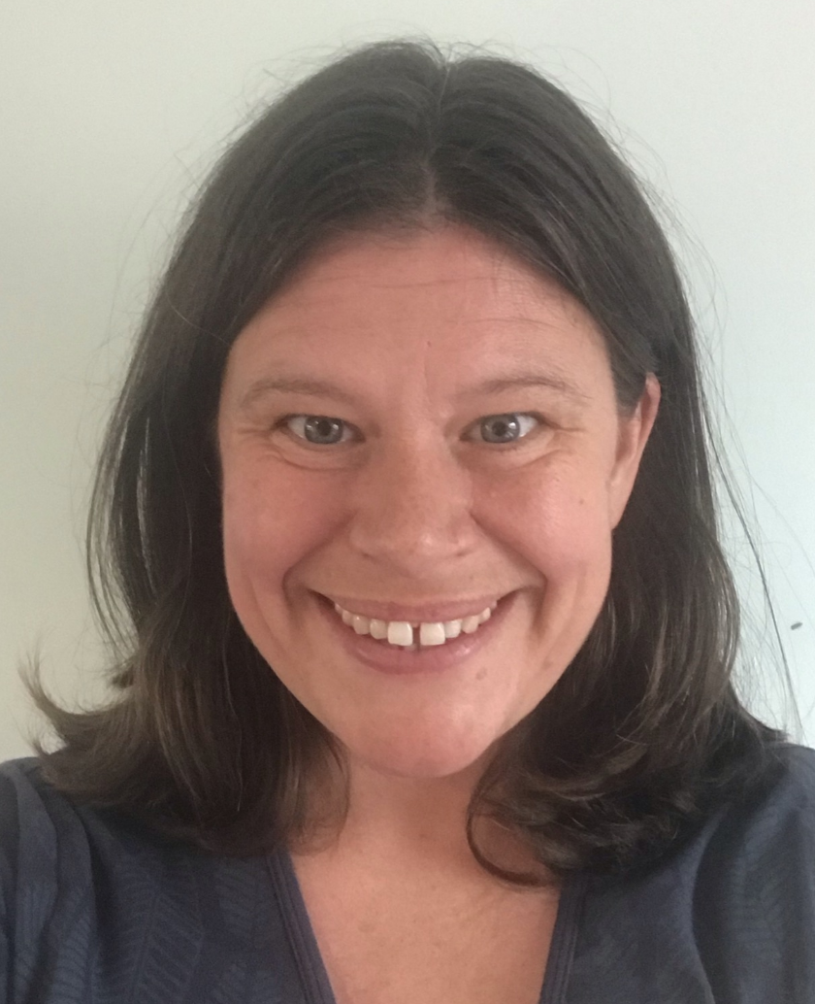
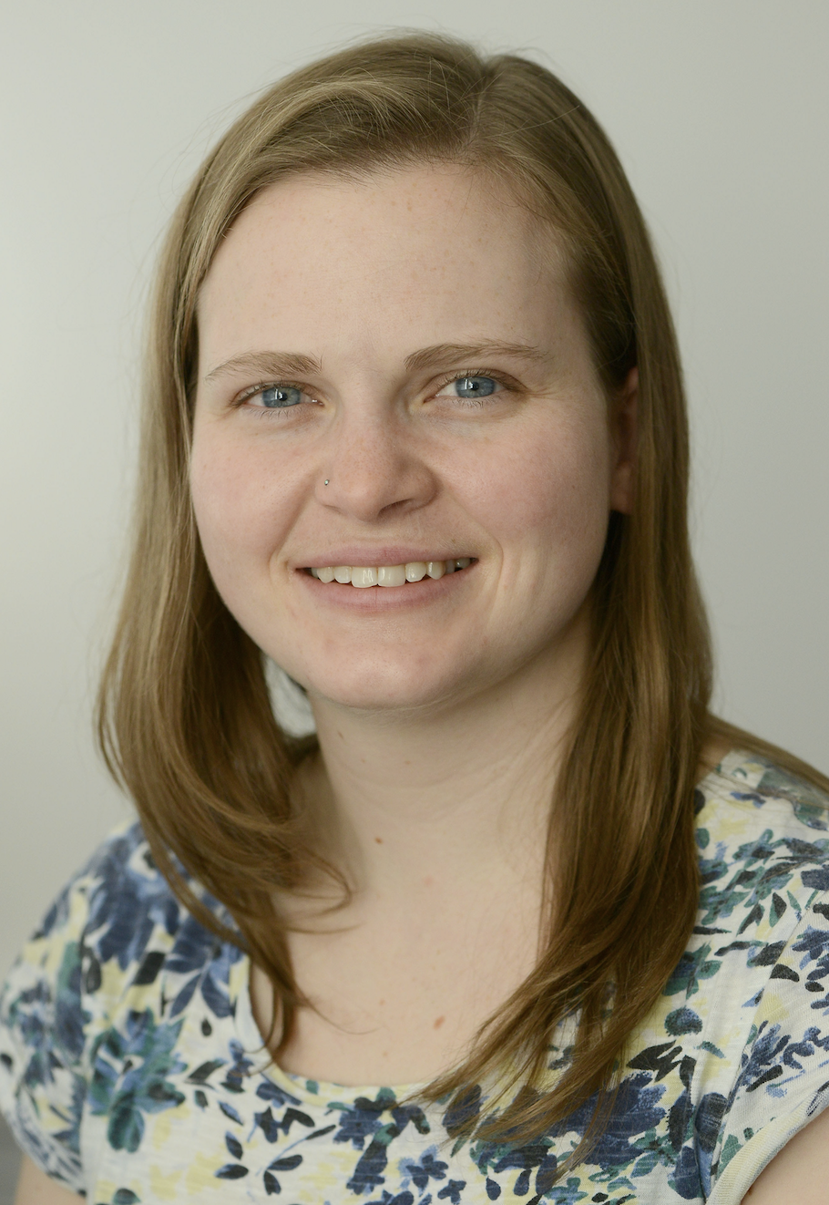
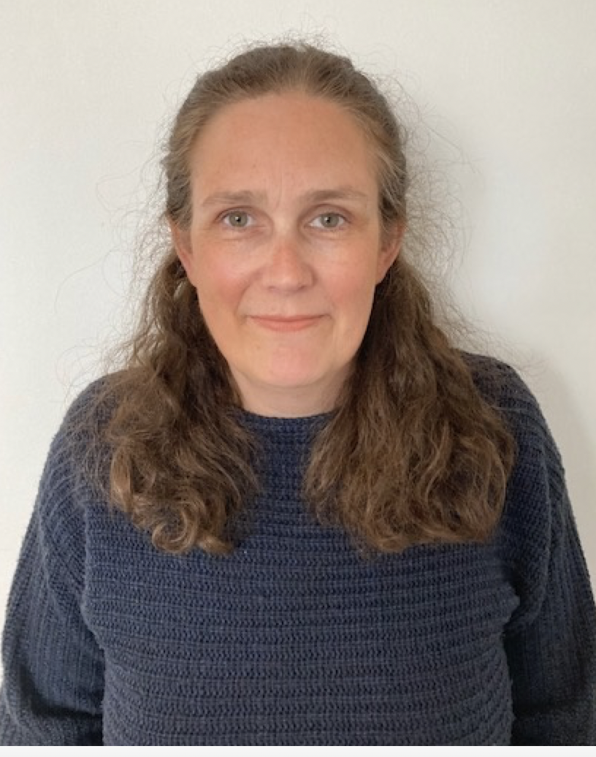
Introductions
Integrating Health Research: Mechanisms to Populations
Strand Co-Leads
Strand Senior Research Associate
Strand Administration
Emma Vincent
Chrissy Hammond
Ruth Mitchell
Esther Kissane-Webb

Slide 4
Integrating Health Research: Mechanisms to Populations

Slide 5
Why is this Research Strand needed?
Barriers to undertaking interdisciplinary research:
Language
Feasibility
Skills
Time
Expectations

Slide 6
How to we break down the barriers?
What is needed and what can we offer?
A home for interdisciplinary research.
Contact point / communications
Researcher time and expertise.
Community building.
Get involved
What can this Strand do for you?
Become part of the community.
Ruth Mitchell

Slide 7
When to engage?
Project timeline
Submit
ID project
proposal
Strand
Engagement:
Community
building
Initiate
collaboration
Prelim
data
Publication
data
Training
Grant / Fellowship
submission
Paper submission

Slide 8
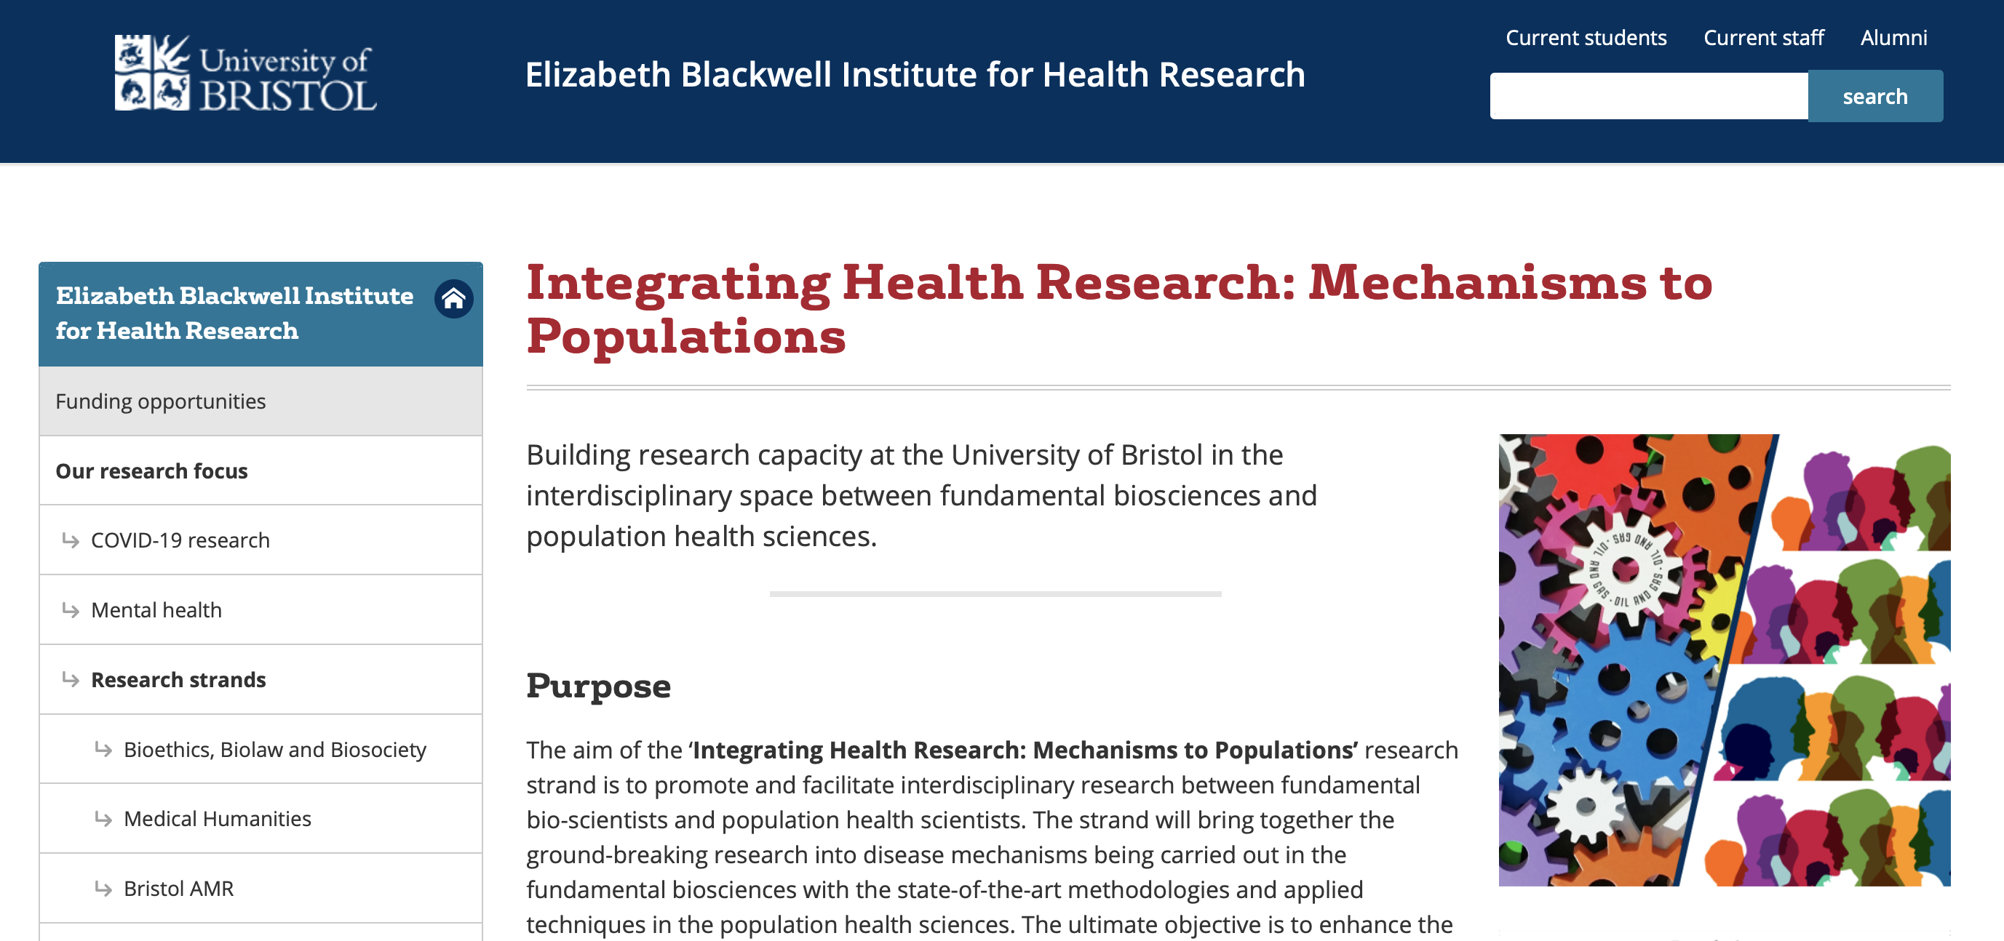
Engage with us
ebi-mechanisms-populations@bristol.ac.uk
www.bristol.ac.uk/blackwell/health-research/research-strands/mechanisms-to-populations/

Slide 9
Integrating Health Research: Mechanisms to Populations

